Slide 1

GESTURE VOLUME CONTROL
Presented By
Lokam Teja Ram – B200793CS
E Krishna Prasad – B200803CS
Abhina Sunny – B200692CS
P Gnana Prakash – B200840CS
Anagha M V – B200762CS

Slide 2
INTRODUCTION
Our project introduces a way to control volume using hand gestures, making technology more intuitive and interactive.
Hand gestures are the most effortless and natural way of communication.
Instead of using the more expensive sensors , a simple web camera can identify the gesture and perform the action
This innovation provides users with a user-friendly, hands-free approach to managing audio volume."

Slide 3
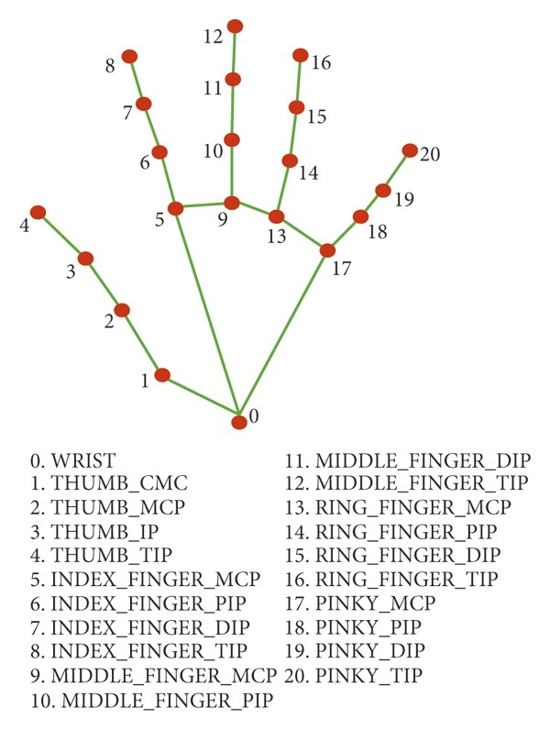
METHODOLOGY
Capture video using OpenCV.
Detect Hands and Hand Tips using Mediapipe.
Identification of tips of the index and thumb finger
Calculate the distance between the fingers
Set volume level accordingly
Press q to Terminate

Slide 4
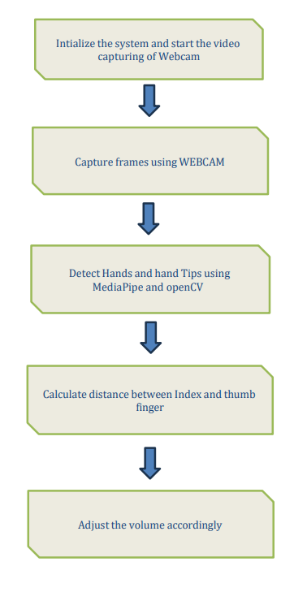
Flow chart

Slide 5
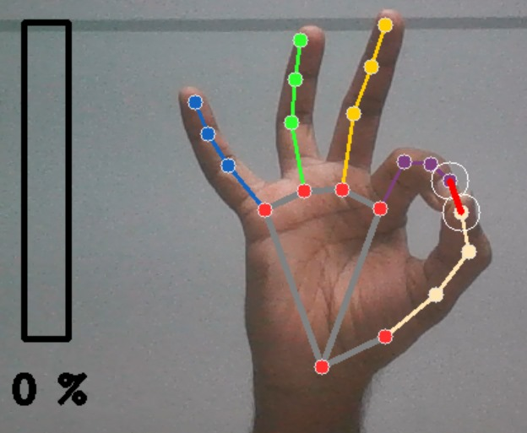
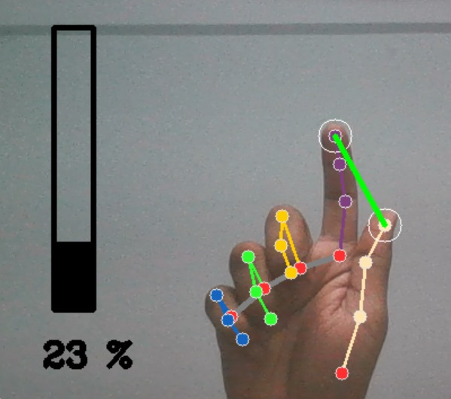
RESULTS

Slide 6
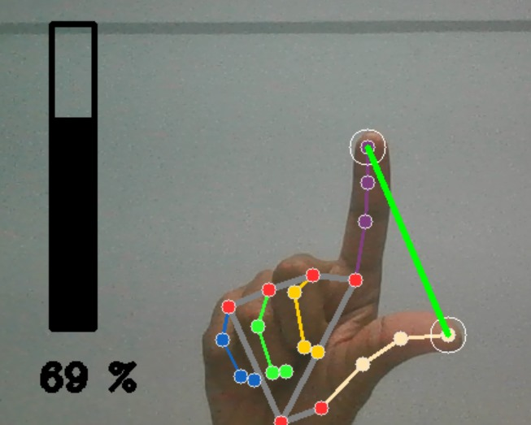
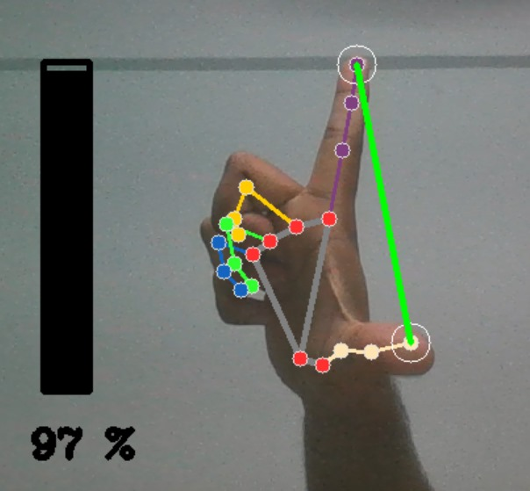
RESULTS

Slide 7
REFERENCES
[1] Gesture volume control using opencv, IRJMETS, 2022 https://www.irjmets.com/uploadedfiles/paper//issue_6_june_2022/27042/final/fin_irjmets1656354635.pd
https://developers.google.com/mediapipe
https://opencv.org/
pycaw

Slide 8
THANK YOU

